Slide 1


<Jeong Hun Kang>
<2022-01-27>

Slide 2

Outline
Executive Summary
Introduction
Methodology
Results
Conclusion
Appendix

Slide 3
Executive Summary
Summary of methodologies
Data Collection
Data Wrangling
EDA with Data Visualization
EDA with SQL
Building an interactive map with Folium
Building a Dashboard with Plotly Dash
Predictive Analysis with Machine Learning
Summary of all results
Exploratory Data Analysis
Interactive Analytics demo
Predictive Analytics

Slide 4
Introduction
Project background and context
We predicted if the Falcon 9 first stage will land successfully. SpaceX advertises Falcon 9 rocket launches on its website, with a cost of 62 million dollars; other providers cost upward of 165 million dollars each, much of the savings is because SpaceX can reuse the first stage. Therefore, if we can determine if the first stage will land, we can determine the cost of a launch. This information can be used if an alternate company wants to bid against SpaceX for a rocket launch.
Problems you want to find answers
What influences for the rocket to land successfully
The effect of each relationship with certain rocket variables will impact in determining the success rate of a successful landing

Slide 5


Slide 6
Methodology
Executive Summary
Data collection methodology:
SpaceX Rest API and Web Scraping from Wikipedia
Perform data wrangling
Dropped irrelevant columns and used One Hot Encoding for data fields that will be used in Machine Learning
Perform exploratory data analysis (EDA) using visualization and SQL
Perform interactive visual analytics using Folium and Plotly Dash
Perform predictive analysis using classification models
How to build, tune, evaluate classification models

Slide 7
Data Collection
Describe how data sets were collected.
We worked with SpaceX launch data that is gathered from the SpaceX REST API.
This API will give us data about launches, including information about the rocket used, payload delivered, launch specifications, landing specifications, and landing outcome.
Our goal is to use this data to predict whether SpaceX will attempt to land a rocket or not.
The SpaceX REST API endpoints, or URL, starts with api.spacexdata.com/v4/.
You need to present your data collection process use key phrases and flowcharts
SpaceX Rest API
API return with JSON
Normalize JSON Data into csv data

Slide 8
Data Collection – SpaceX API
GitHub Link
1 .Getting Response from API
4. Assign list to dictionary then dataframe
2. Converting Response to a .json file
3. Apply custom functions to clean data

Slide 9
Data Wrangling
GitHub Link
Perform Exploratory Data Analysis EDA on dataset
Calculate the number of launches at each site
Calculate the occurrence of each orbit
Calculate the number and occurrence of mission outcome per orbit type

Slide 10
EDA with Data Visualization
GitHub Link
Scatter Plots
Flight Number vs Payload Mass
Flight Number vs Launch Site
Payload vs Launch Site
Orbit vs Flight Number
Bar Graph
Mean vs Orbit
Line Graph
Success Rate vs Year

Slide 11
Build an Interactive Map with Folium
GitHub Link
To visualize the Launch Data into an interactive map, the Latitude and Longitude Coordinates at each launch site was used and added a Circle Marker around each launch site with a label of the name of the launch site.
To visualize the success marker more clearly, we assigned the dataframe launch_outcomes(failures, successes) to 0 and 1 with Green and Red markers on the map in a MarkerCluster()
To visualize the distance from the site, we used Haversine’s formula and calculated the distance from the Launch Site to various landmarks to find various trends about what is around the Launch Site to measure patterns. Lines are drawn on the map to measure distance to landmarks

Slide 12
Build a Dashboard with Plotly Dash
GitHub Link
Dashboard Graph
Pie Chart of success count for all launch sites
Pie Chart of each site’s total success launches
Plot graph of success counts on payload mass for all sites
Range Slider to select payload included
Plot graph of success counts on payload mass for each site

Slide 13
Predictive Analysis (Classification)
GitHub Link
BUILDING MODEL
Load our dataset into NumPy and Pandas
Transform Data
Split our data into training and test data sets
Check how many test samples we have
Decide which type of machine learning algorithms we want to use
Set our parameters and algorithms to GridSearchCV
Fit our datasets into the GridSearchCV objects and train our dataset.
EVALUATING MODEL
Check accuracy for each model
Get tuned hyperparameters for each type of algorithms
Plot Confusion Matrix
IMPROVING MODEL
Feature Engineering
Algorithm Tuning
FINDING THE BEST PERFORMING CLASSIFICATION MODEL
The model with the best accuracy score wins the best performing model
In the notebook there is a dictionary of algorithms with scores at the bottom of the notebook.

Slide 14
Results
Exploratory data analysis results
Interactive analytics demo in screenshots
Predictive analysis results

Slide 15


Slide 16
Flight Number vs. Launch Site
The more amount of flights at a launch site the greater the
success rate at a launch site.

Slide 17
Payload vs. Launch Site
The greater the payload mass for Launch Site CCAFS SLC 40 the higher the success rate for the Rocket.
There is not quite a clear pattern to be found using this visualization to make a decision if the Launch Site is
dependent on Pay Load Mass for a success launch.

Slide 18
Success Rate vs. Orbit Type
Orbit GEO,HEO,SSO,ES
L1 has the best Success
Rate

Slide 19
Flight Number vs. Orbit Type
You should see that in the LEO
orbit the Success appears related
to the number of flights; on the
other hand, there seems to be no
relationship between flight number
when in GTO orbit.

Slide 20
Payload vs. Orbit Type
You should observe that Heavy
payloads have a negative influence
on GTO orbits and positive on GTO
and Polar LEO (ISS) orbits.

Slide 21
Launch Success Yearly Trend
you can observe that
the success rate since
2013 kept increasing till
2020

Slide 22
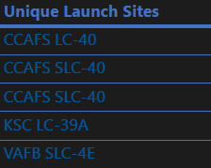
All Launch Site Names
select DISTINCT Launch_Site from tblSpaceX
QUERY EXPLAINATION
Using the word DISTINCT in the query means that it will only show Unique values in the Launch_Site column from tblSpaceX

Slide 23
Launch Site Names Begin with 'CCA'
selectTOP 5 from tblSpaceX WHERE Launch_Site LIKE ‘CCA%’
QUERY EXPLAINATION
Using the word TOP 5 in the query means that it will only show 5 records from tblSpaceX and LIKE keyword has a wild card with the words‘ the percentage in the end suggests that the Launch_Site name must start with CCA.

Slide 24
Total Payload Mass
Select SUM(PAYLOAD_MASS_KG_) TotalPayloadMass from tblSpaceX where Customer =='NASA (CRS)'",'TotalPayloadMass
QUERY EXPLAINATION
Using the function SUM summates the total in the column PAYLOAD_MASS_KG
The WHERE clause filters the dataset to only perform calculations on Customer NASA (CRS)

Slide 25
Average Payload Mass by F9 v1.1
Select AVG(PAYLOAD_MASS_KG_) AveragePayloadMass from tblSpaceX where Booster_Version =='F9 v1.1’
QUERY EXPLAINATION
Using the function AVG works out the average in the column PAYLOAD_MASS_KG_
The WHERE clause filters the dataset to only perform calculations on Booster_version F9 v1.1

Slide 26
First Successful Ground Landing Date
Select MIN(Date) SLO from tblSpaceX where Landing_Outcome ==”Success (drone ship)”
QUERY EXPLAINATION
Using the function MIN works out the minimum date in the column Date
The WHERE clause filters the dataset to only perform calculations on Landing_Outcome Success (drone ship)

Slide 27
Successful Drone Ship Landing with Payload between 4000 and 6000
Select Booster_Version from tblSpaceX where Landing_Outcome =='Success (ground pad)’ AND Payload_MASS_KG 4000 AND Payload_MASS_KG 6000
QUERY EXPLAINATION
Selecting only Booster_Version
The WHERE clause filters the dataset to Landing_Outcome = Success (drone ship)
The AND clause specifies additional filter conditions Payload_MASS_KG 4000 AND Payload_MASS_KG 6000

Slide 28
Total Number of Successful and Failure Mission Outcomes
SELECT(SELECT Count( Mission_Outcome from tblSpaceX where Mission_Outcome LIKE '%Success%’) as Successful_Mission_Outcomes (SELECT Count( Mission_Outcome from tblSpaceX where Mission_Outcome LIKE ''%Failure%’) as Failure_Mission _Coutcomes
QUERY EXPLAINATION
a much harder query I must say, we used subqueries here to produce the results. The LIKE ‘%foo%’ wildcard shows that in the record the foo phrase is in any part of the string in the records for example.

Slide 29
Boosters Carried Maximum Payload
SELECT DISTINCT Booster_Version, MAX(PAYLOAD_MASS_ AS [Maximum Payload Mass] FROM tblSpaceX GROUP BY Booster_Version ORDER BY [Maximum Payload Mass] DESC
QUERY EXPLAINATION
Using the word DISTINCT in the query means that it will only show Unique values in the Booster_Version column from tblSpaceX GROUP BY puts the list in order set to a certain condition. DESC means its arranging the dataset into descending order

Slide 30
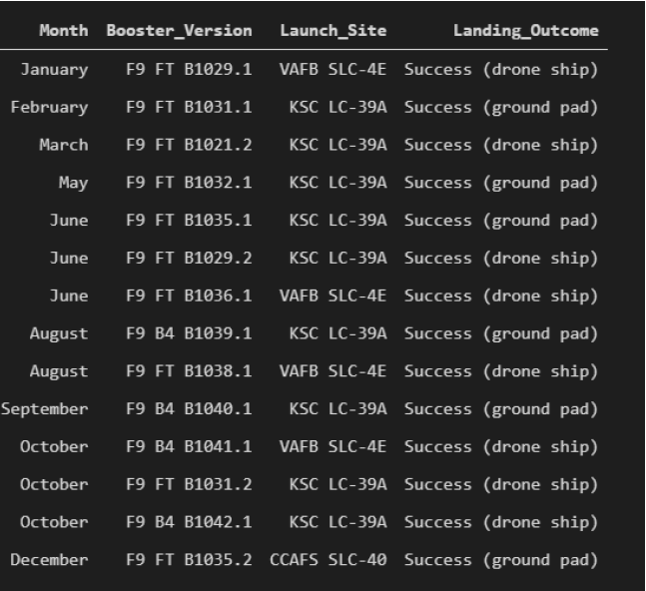
2015 Launch Records
SELECT DATENAME(month, DATEADD(month, MONTH(CONVERT(date, Date, 105)), 0) 1) AS Month, Booster_Version, Launch_Site, Landing_Outcome FROM tblSpaceX WHERE (Landing_Outcome LIKE '%Success %') AND (YEAR(CONVERT(date, Date, 105)) = ‘2015’)
QUERY EXPLAINATION
a much more complex query as I had my Date fields in SQL Server stored as NVARCHAR the MONTH function returns name month. The function CONVERT converts NVARCHAR to Date WHERE clause filters Year to be 2017

Slide 31
Rank Landing Outcomes Between 2010-06-04 and 2017-03-20
SELECT COUNT(Landing_Outcome) FROM tblSpaceX WHERE (Landing_Outcome LIKE '%Success%’) AND (Date > ‘04 06 2010’) AND (Date < ‘20 03 2017')
QUERY EXPLAINATION
Function COUNT counts records in column WHERE filters data
LIKE (wildcard), AND (conditions), AND (conditions)

Slide 32


Slide 33
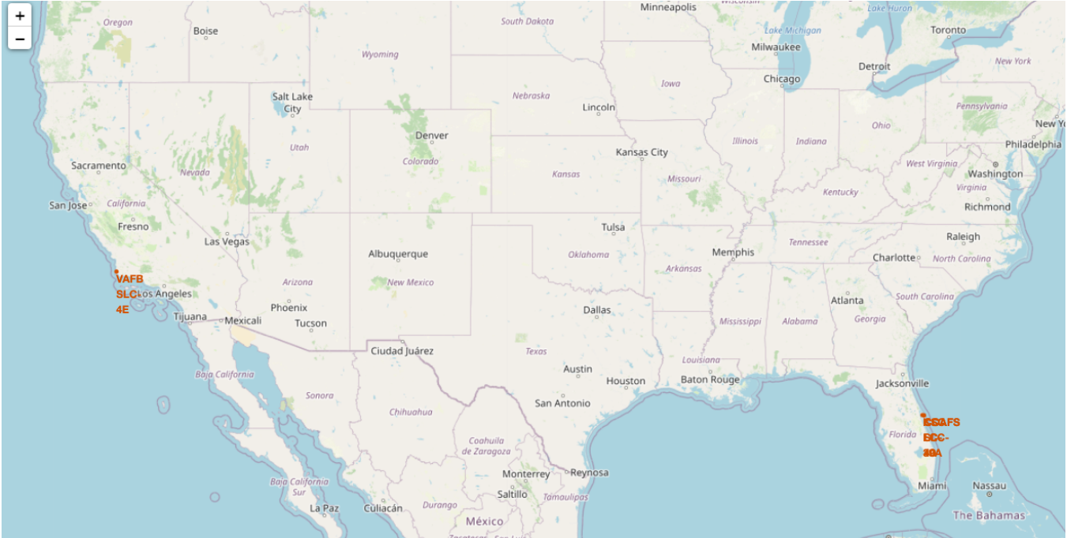
<Mark all launch sites on a map with Folium>
All launch sites are in very close proximity to the coast

Slide 34
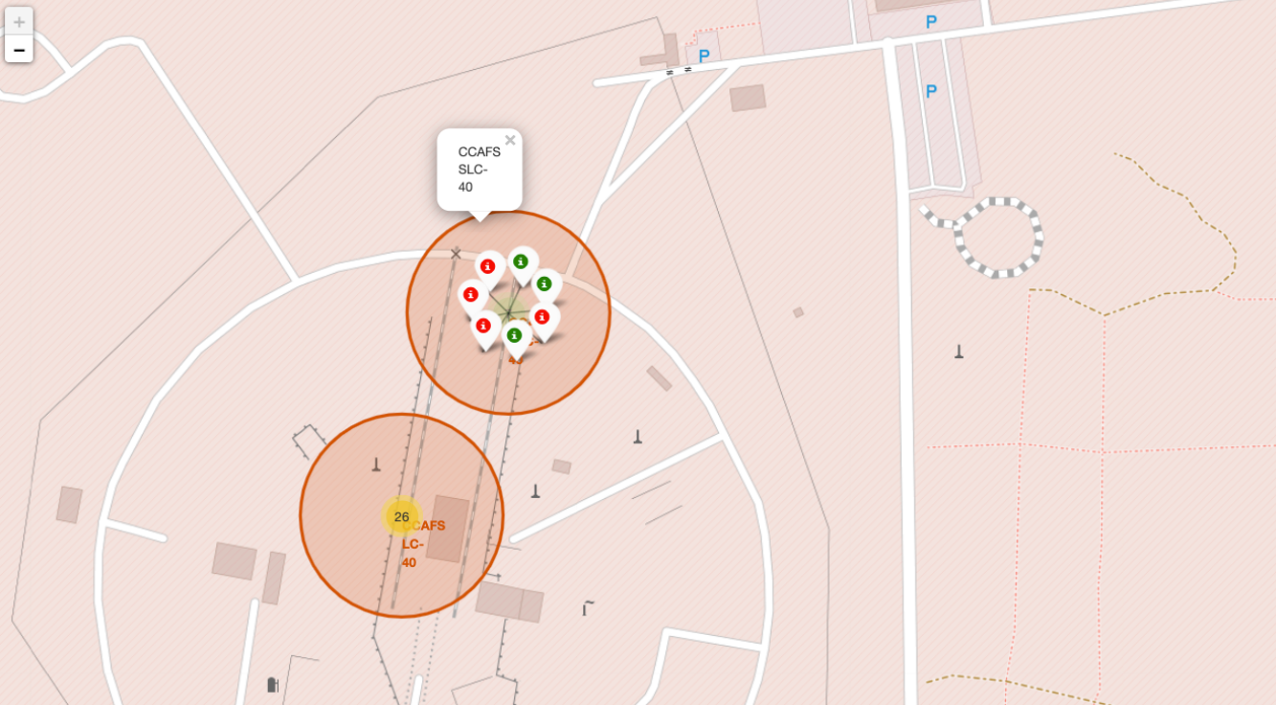
<Mark success/failed launches on a map with Folium>
From the color-labeled markers in marker clusters, we can easily identify which launch sites have relatively high success rates.

Slide 35
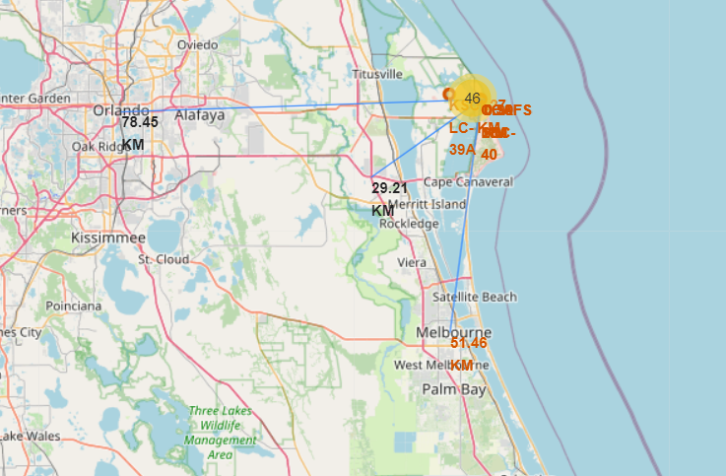
<Mark distances between a launch site to its proximities with Folium>

Slide 36


Slide 37
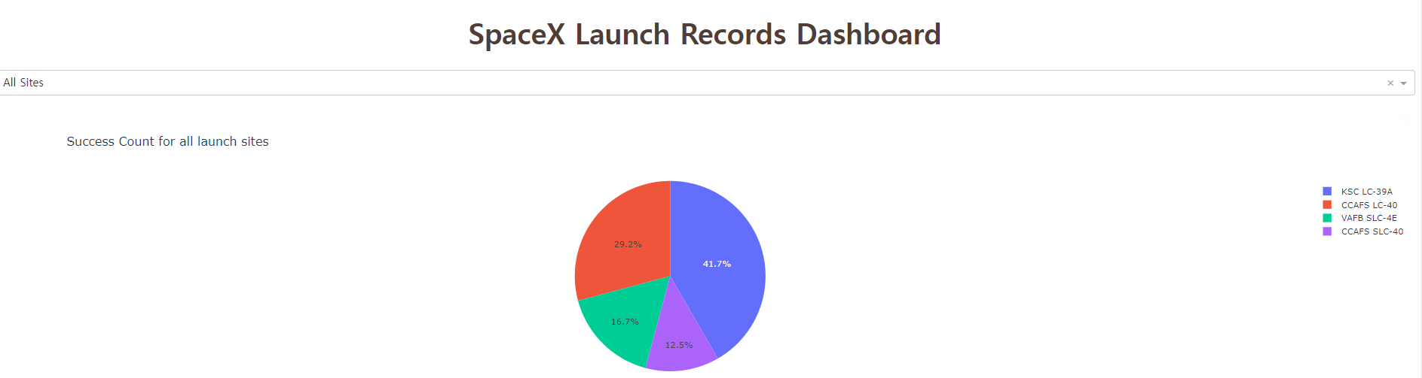
<Dashboard – Launch Success Count for all Sites>
Dashboard containing selection of each site and all sites

Slide 38
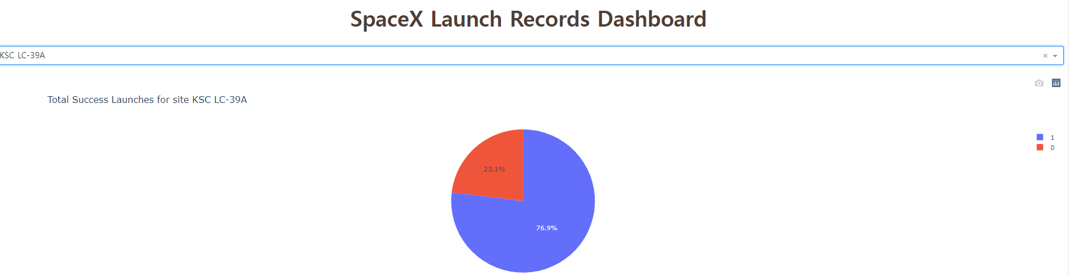
<Dashboard – Highest Launch Success Ratio>
KSC LC-39A has the highest success ratio

Slide 39
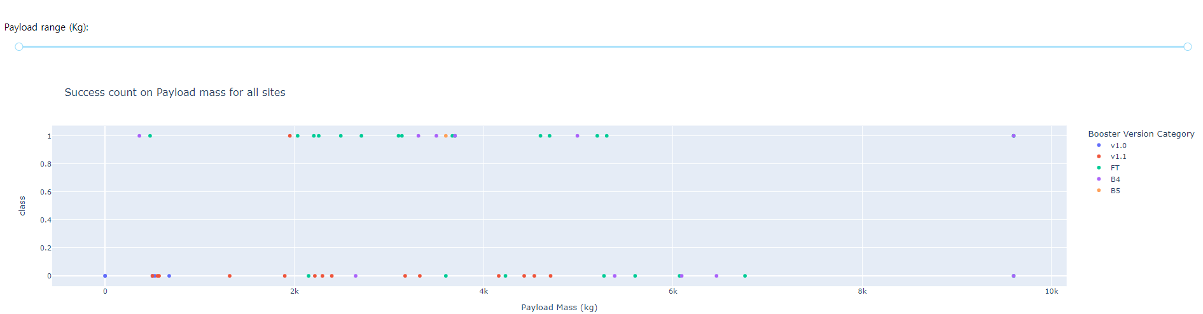
<Dashboard – Payload vs. Launch Outcome scatter plot >
We can adjust payload range slide bar for limited search and compare

Slide 40


Slide 41
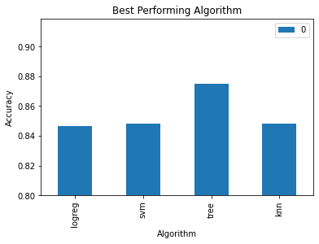
Classification Accuracy
Tree Algorithm performs the best in terms of accuracy

Slide 42
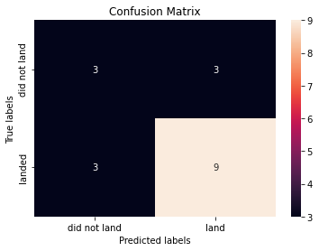
Confusion Matrix
Examining the confusion matrix, we see that Tree can distinguish between the different classes.

Slide 43
Conclusions
The Tree Classifier Algorithm is the best for Machine Learning for this dataset
Low weighted payloads perform better than the heavier payloads
The success rates for SpaceX launches is directly proportional time in years they will eventually perfect the launches
We can see that KSC LC 39A had the most successful launches from all the sites
Orbit GEO,HEO,SSO,ES L1 has the best Success Rate

Slide 44


